Slide 1
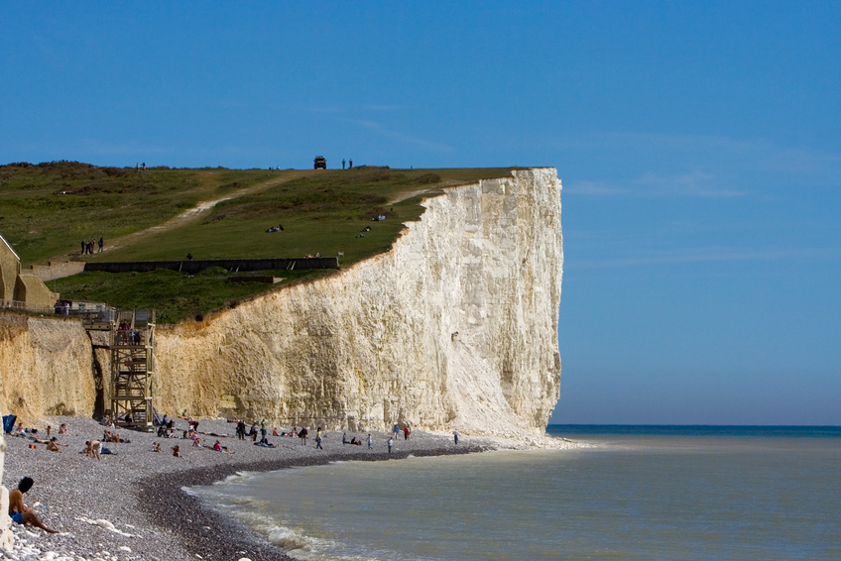
SC1101E
REVIEW LECTURE
(Tan ES)

Slide 2
Today’s
Tutors on strengths and weaknesses detected in SA, MTT and CP, and suggestions on how to “catch” the sociological imagination.
Dr Kelvin Low reviews culture, family, ethnicity, gender/sexuality, and deviance.
I will review sociology as a way of seeing, doing sociology, power, class, religion, and elderly.
Advice on Final Exam
Notes:
Do not contradict yourself. Topics are interrelated. Do not merely cite articles and theories but use examples to substantiate your arguments. How to structure ur essay: do not use according to the perspectives but just be direct to answer the question and demonstrating what we know. Some perspectives are more appropriate. Most important topics are power, culture and the introduction topic. Culture should be paired with power/ deviance. Need to read the question: essential versus essentialism. Good essays has an element of originality. Concise and coherent. Facts should correct.

Slide 3
Sociology as a way of seeing and Doing Sociology (1)
What is so special about Sociology?
subject matter (“social”) and scientific methods.
How is Sociology different from common-sense?
testable hypotheses, objective methods, representative samples.
How is writing sociologically different from writing a GP essay?
mobilise sociological theories, concepts, findings; focusing on the “social”.
Notes:
We study society, social scientifically. Alternative conceptions on how society can be ordered.

Slide 4
Sociology as a way of seeing and Doing Sociology (2)
Why should I care about the dead heroes/ heroines of Sociology?
They deal with fundamental issues of social order, social structure, social change; and with methodology.
How are sociological perspectives different from sociological theories?
Perspectives point you to what to look at; theories help to explain.
Perspectives=broad, provides an angle; Theories=connecting specific variables.
We can reject theories, if found inadequate.

Slide 5
Sociology as a way of seeing and Doing Sociology (3)
Is objectivity possible?
Yes, using unbiased methods, and not allowing our values to influence our interpretations of data.
What research methods should we use?
It depends on time, resources, accessibility and of course, our research questions.
Triangulation of methods.
Capturing meanings and actions.

Slide 6
Power (1)
How is power so fundamental in social Life?
Think of culture, socialization, deviance, for instance.
Why do people obey?
control, pragmatic acceptance, legitimacy/ authority.
How would you describe the power structure in a country you are familiar with?
Use one or more of the power theories.
Notes:
Power is found in all social relations. Marxist: Upper class and the lower class.

Slide 7
Power (2)
Is the exercise of power always observable?
Lukes’s 3 faces of power, Foucault’s
Democracy=rule by the people. Who are the people in a country you are familiar with?
Citizens (not foreigners), interest groups, heterogeneous (culture, class, ethnicity, religion, age).
Is a depoliticized society possible?
Imagine absence of power—possible? Presence of different groups with different interests/ agendas.
Politics is more than just electoral politics.

Slide 8
Power (3)
What does “modern state” entail?
Nation-building: national identity, multiculturalism.
Economic development and welfare.
Governance and democracy: political participation, freedom of speech and assembly, accountability, responsiveness, rule of law, welfare provisions.

Slide 9
Class (1)
How do the various theories define and locate the middle class?
Marx, Weber, Wright, Goldthorpe, functionalist.
To be middle class is to be in a secure and comfortable position. Do you agree?
Not quite. Stagnant income, high cost of living, redundancy, job loss, downward mobility. (cf. Newman’s article)

Slide 10
Class (2)
Is inequality inevitable? Is it necessary?
depends on perspectives.
Is there such a thing as “functional importance”?
mental-manual/ brain-brawn → power.
Is “means of production” fundamental for understanding capitalist society?
private ownership of capital, class structure, conflict, exploitative relations.

Slide 11
Religion
What is religion?
Relationship with the supernatural.
Does modernity spell the demise of religion?
Secularization: cathedrals in Europe.
Value shift: traditions loosening hold over us.
Is religion very much alive?
Deals with ultimate meanings; handling uncertainties, and risks.
Private sphere, personal choice
Religious economy (Stark)
Church-sect cycle
Fundamentalism
Notes:
Fundamentalism as a response to post-modernisation.

Slide 12
Elderly
How would you explain the emergence of the aging population?
demographic transition: high birth and death rates,…low birth and death rates.
What determines “age” of a person in society?
cultural, rather than biological.
How can we dissociate aging from downward mobility?
retirement planning, employability, restructure life-course.
Do elderly people constitute a minority?
size and power.

Slide 13
Reading Week: Consultation
Simple questions could be handled over emails.
Complex ones, including practice essays--face-to-face.
Make appointment to speak with your tutor.
Group consultation preferred.

Slide 14
Final Exam
2 sections: 3C1 + 3C1 = 2 Closed book, 2-hr exam Double-check date/time/venue
The key really is to pay attention to what we have emphasized, and to develop a mind map.
Choose a question which allows you to showcase your strengths and shine Answer the question in front of you Plan your answers Select your ammo: quality, not quantity Keep your paragraph to at most ½ page Legible handwriting, neat presentation
Be well rested

